Slide 1

Development of Open Source in the pharmaceutical industry Sharing information from RPharma2024
Zehui Bai
Senior Biostatistician II
27-Feb-2025

Slide 2
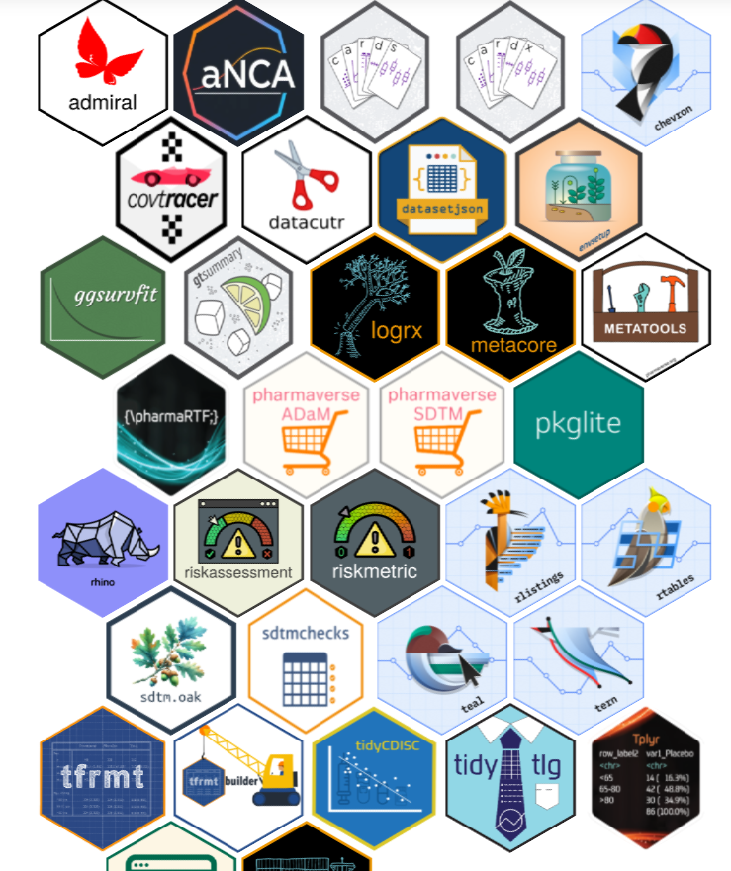
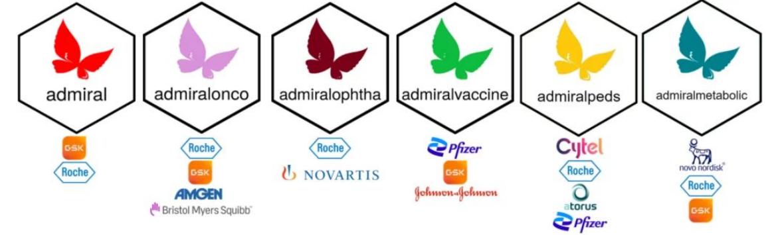
pharmaverse - From openstatsware & pharmaverse, to a full R Submission.
https://pharmaverse.org/
https://efspieurope.github.io/workshop/data/2024/slides/52_Perttola.pdf
A connected network of companies and individuals working to promote collaborative development of curated open source R packages for clinical reporting usage in pharma, in a space where previously we would only ever have worked in silos on our own closed source and often duplicative solutions. Adopting shared solutions in this post-competitive space should ultimately ease regulatory review, resulting in bringing new treatments to patients faster.

Slide 3
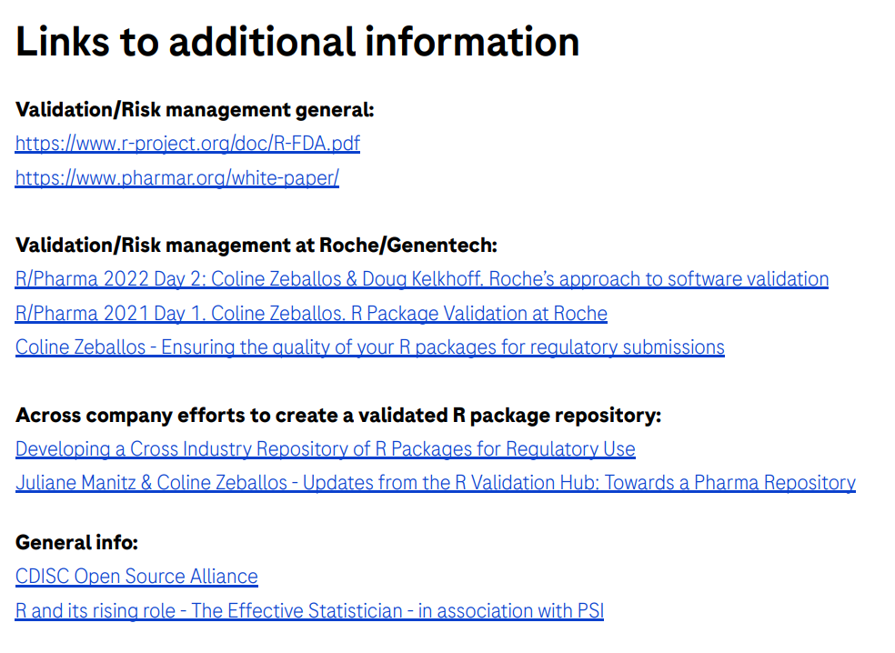
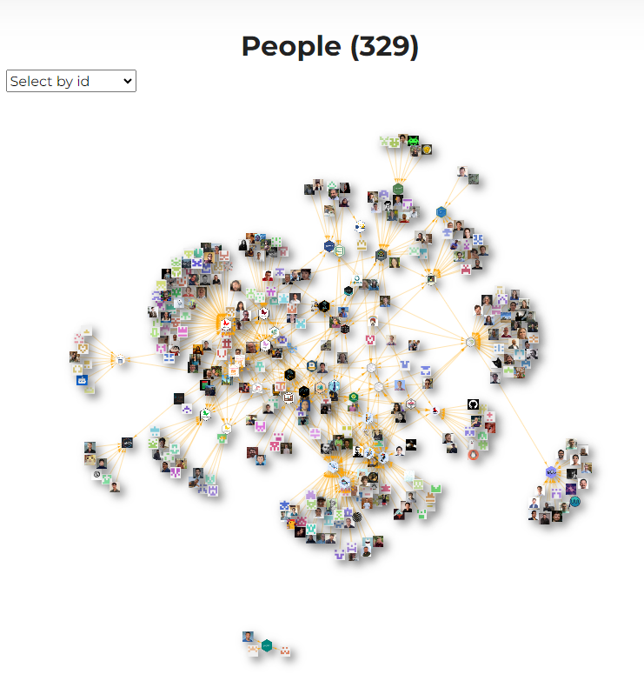
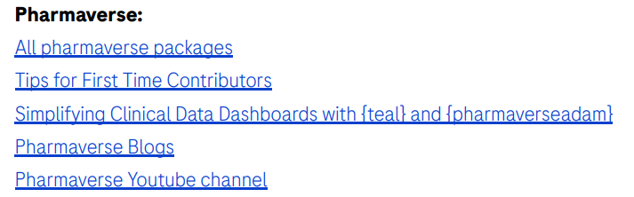

Roche – R Development

Slide 4
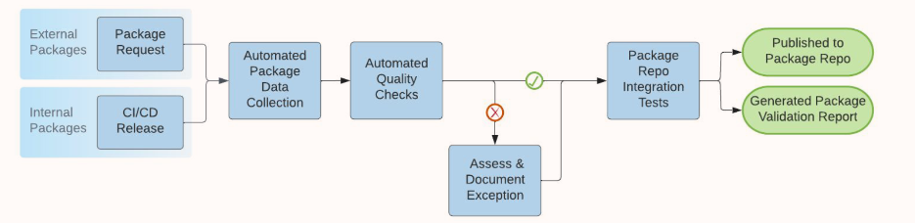
Roche - Automating R package validation
https://github.com/pharmaR/case_studies/blob/fa5e4c82098266fe7516adaa8671a64c9796a0e3/Roche_Rpkg_validation_2022.pdf
Submission
Data Collection
Quality Checks
Addressing Gaps
Reiteration Process
Post-Validation

Slide 5
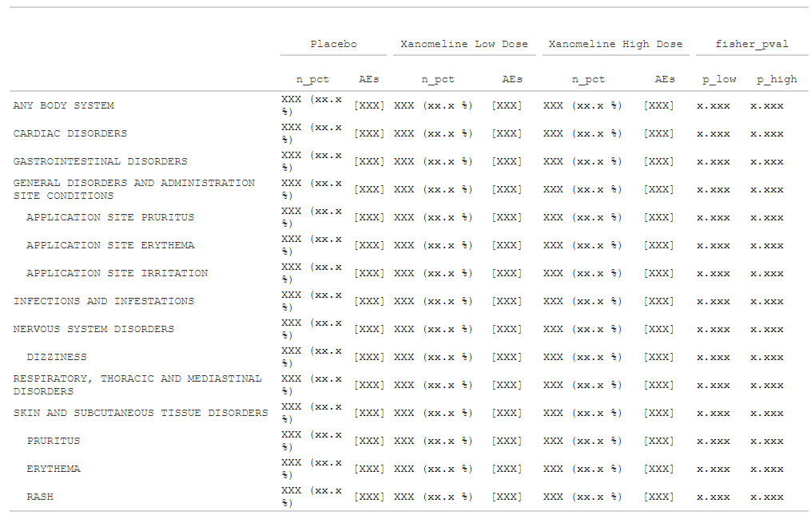
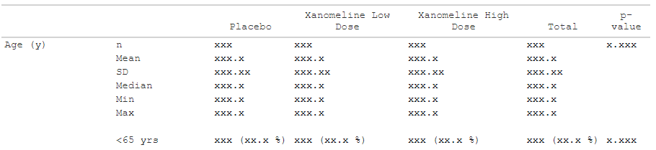
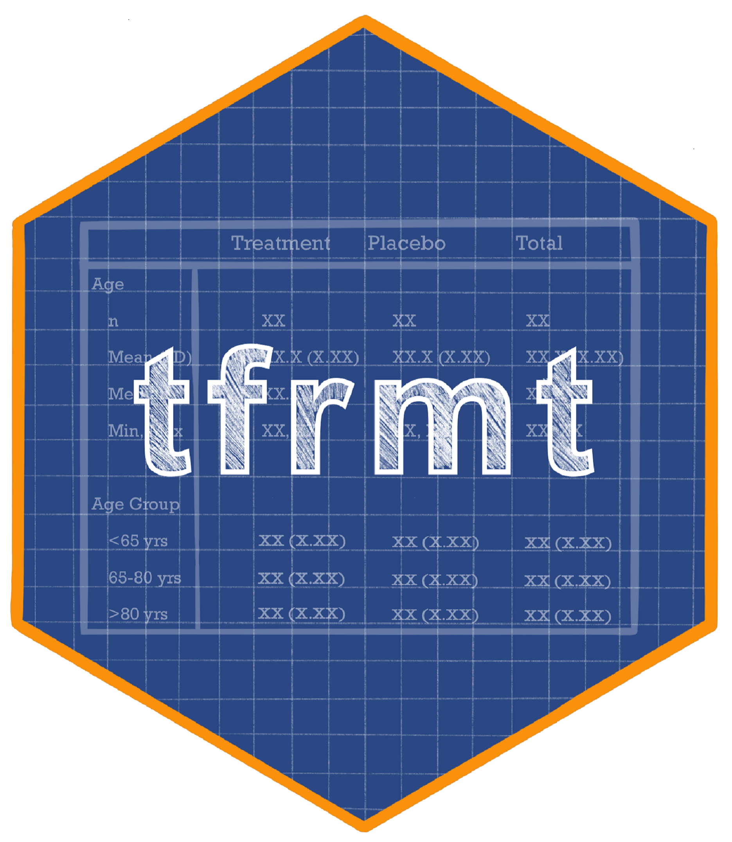

GSK - Automation of reporting statistical results
https://github.com/GSK-Biostatistics/tfrmt
https://gsk-biostatistics.github.io/tfrmt/articles/examples.html
tfrmt supports a vision where:
Mock displays are integrated with the programming workflow
Results are QC’ed prior to formatting to reduce rework
Standard formatting styles can be applied in as little as one line of code
The ARD structure can be leveraged to accommodate a variety of tables
Notes:
Design the table using flextable package
Frame reporting using rmarkdown package

Slide 6
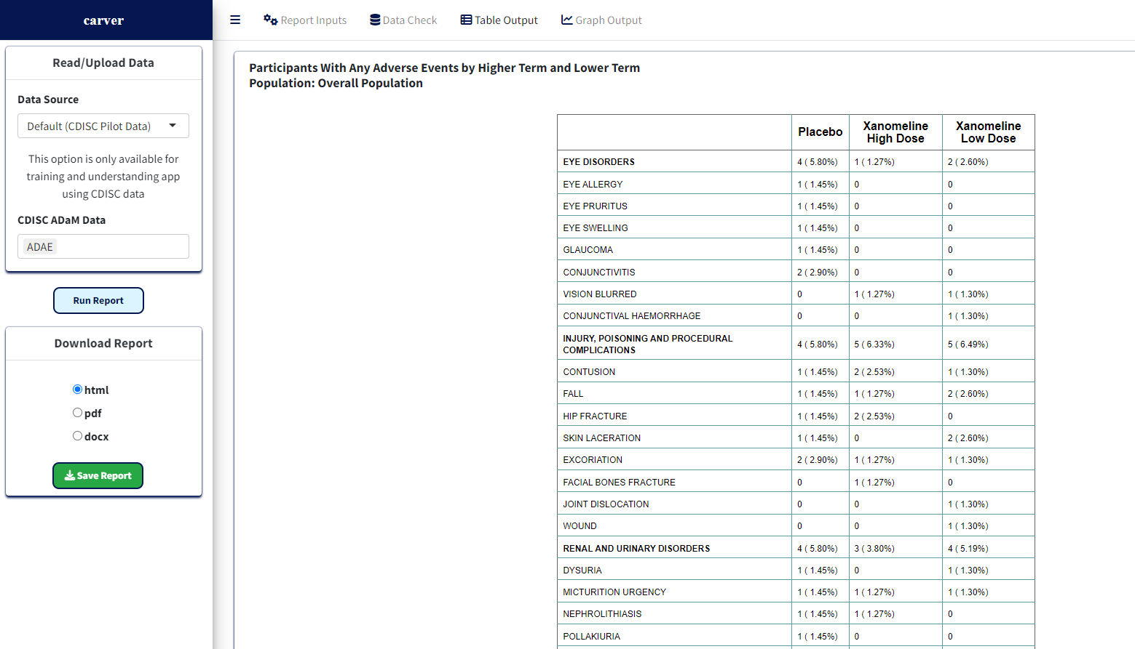


Pfizer - carver Clinical Analysis Report and Visualization

Slide 7
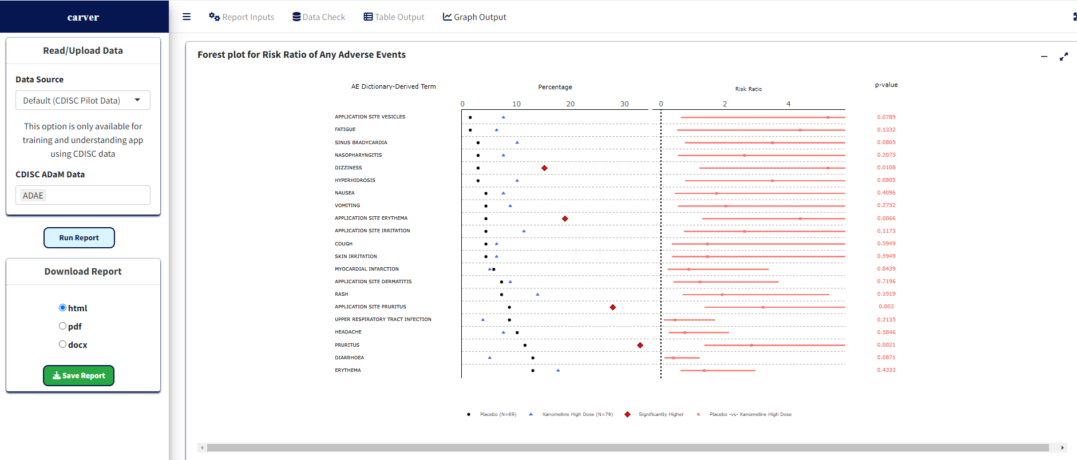
Pfizer - carver Clinical Analysis Report and Visualization

Slide 8
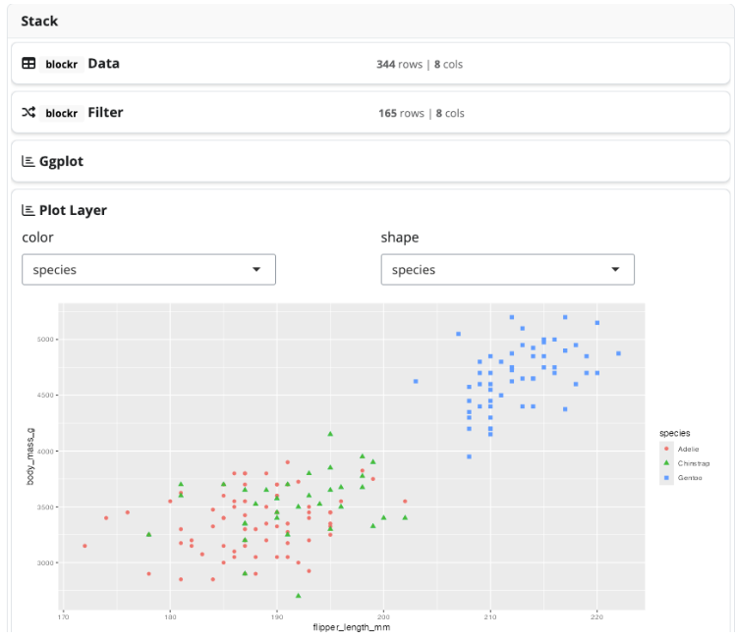

BMS – blockr a no code dashboard with blockr for R
https://bristolmyerssquibb.github.io/blockr/index.html https://bristolmyerssquibb.github.io/blockr.workshop/
👉 Demo: https://lnkd.in/dzYTCeFz 💡 Discover the power of blockr in other case studies: https://lnkd.in/dmFisVHW
Purpose: blockr is an R package aimed at simplifying data analysis by enabling a flexible, intuitive, and code-free method to build data pipelines.
Non-Technical Users: Empowers users without coding skills to create data workflows using pre-built, connectable blocks, allowing them to visualize insights with minimal effort.

Slide 9
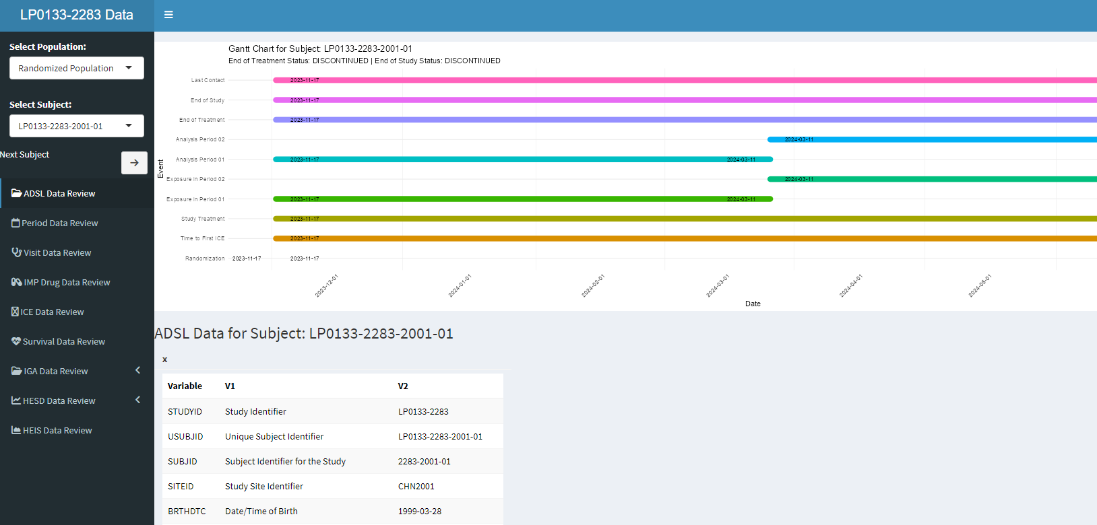
R Shiny and R Dashboard for LEO 2283

Slide 10
Thank you Q&A

